Slide 1

Health Misinformation Detection Based on
AI Techniques
Group members with Student Id
Om Panchal(22106025)
Sarang Bahikar(22106129)
Krishit Doshi(22106001)
Ayush Gupta(22106074)
Project Guide
Prof. Monali Korde

Slide 2
Outline
Introduction
Literature Survey of the Existing Systems
Limitations of the Existing Systems
Problem Statement
Proposed System Design
Framework/Algorithm
Implementation
Conclusion
References

Slide 3
Introduction
In the digital age, health misinformation has become a critical issue, spreading rapidly through social media, news websites, and online forums.
False or misleading health-related information can lead to public confusion, harmful self-medication, and reduced trust in medical professionals.

Slide 4
Literature Survey of the existing system
Author Name | Title | Year | Summary
Despoina Mouratidis, Andreas Kanavos and Katia Kermanidis | From Misinformation to Insight: Machine Learning Strategies for Fake News Detection | 2025 | The paper discusses challenges like data quality and the complexity of detecting misinformation due to social and psychological factors. It also evaluates different machine learning models' performance and suggests future improvements, such as using multimodal data and refining models to better handle evolving misinformation.

Slide 5
Literature Survey of the existing system
Author Name | Title | Year | Summary
Hafiz Muhammad Zeeshan, Inam Ullah, Furkan Yousaf, Amin Sharafian, Md Belal Bin Heyat, Shazia Saqib and Atta Ur Rahman | A Machine Learning-Based Scientometric Evaluation for Fake News Detection | 2025 | It examines key research trends, influential authors, and institutions contributing to the field. The study provides insights into the growth of this area, highlighting the evolution of machine learning models and their effectiveness in addressing misinformation, as well as identifying future research directions and challenges in the field.

Slide 6
Literature Survey of the existing system
Author Name | Title | Year | Summary
Bharti Khemani , Shruti Patil , Ketan Kotecha, Deepali Vora | Detecting health misinformation: A comparative analysis of machine learning and graph convolutional networks in classification tasks | 2024 | The research conducts a comparative analysis of classification models to detect health misinformation, evaluating traditional machine learning models and advanced graph convolutional networks (GCN).

Slide 7
Limitations of Existing Systems
Evasion by Misinformation Spreaders: Misinformation creators continuously adapt their tactics, using slightly modified text, images, or videos to bypass AI filters, making detection systems less effective over time
High False Positives and Negatives: ML models may incorrectly classify legitimate health information as misinformation (false positives) or fail to detect subtle misinformation (false negatives), reducing reliability.
Real-Time Detection Issues: Existing systems struggle with real-time misinformation detection, as fact-checking requires access to verified databases, which may not update quickly in response to evolving health crises.

Slide 8
Problem Statement
The proliferation of misinformation and fake news has become a significant concern, particularly in the health sector, where false claims can have serious consequences for individual’s well-being.
Social media, websites, and blogs often spread health-related misinformation, misleading the public and jeopardizing public health.

Slide 9
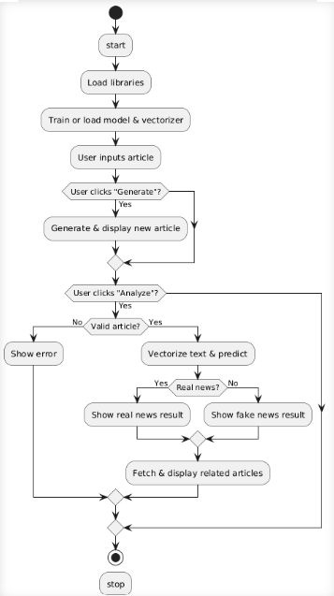
Proposed System Design

Slide 10
Framework/Algorithm
Flask: - A lightweight and flexible Python web framework, serves as the backbone for creating an intuitive and responsive user interface. It enables the deployment of the misinformation detection tool as a web-based application, allowing users to easily input articles, receive analysis results, and explore related content.
Web Scraping / API:
Requests –The requests library in Python is employed to handle HTTP requests, enabling the application to retrieve news content directly from specified URLs
News API – The News API is integrated to source reliable and verified news articles relevant to the user's input. This API provides access to a vast database of articles from reputable sources, which are used to suggest related content and cross-verify the authenticity of the analyzed text
Scikit-learn: Used for data preprocessing (e.g., TF-IDF Vectorization for feature extraction and MinMaxScaler for normalization).

Slide 11
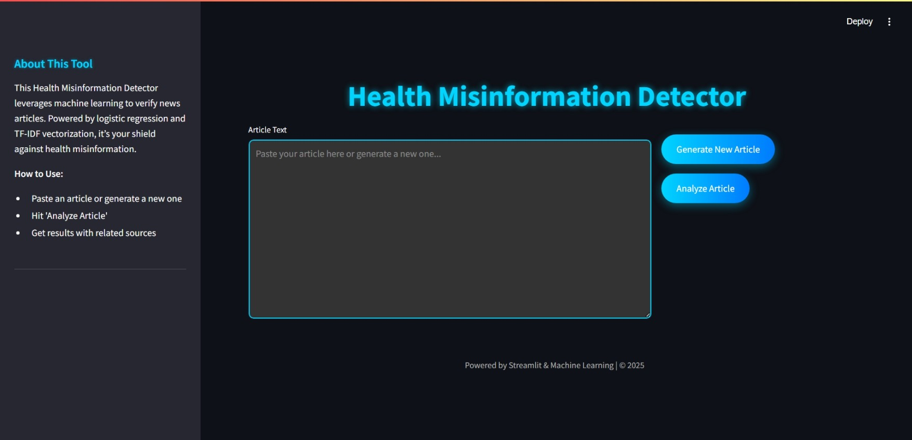
Implementation
Figure 1: DASHBOARD

Slide 12
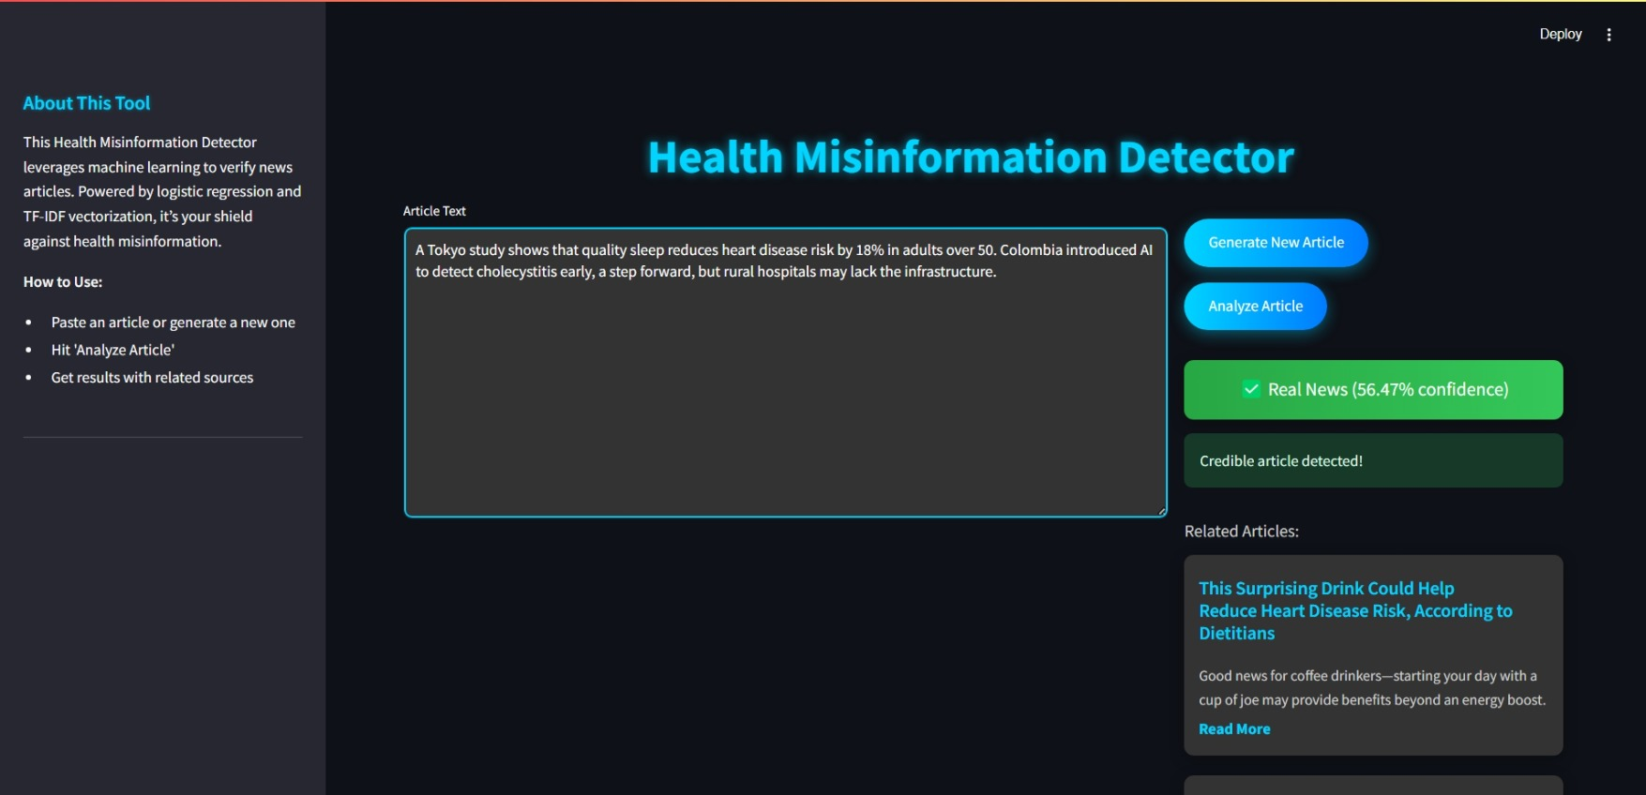
Figure 2: OUTPUT

Slide 13
Conclusion
In conclusion, a fake health news detector powered by AI can significantly improve the accuracy and reliability of health information available online. By using advanced algorithms such as machine learning and natural language processing, these detectors can efficiently identify and flag misleading or false health-related content.
We explored various techniques, trained models on credible datasets, and evaluated their accuracy in detecting misinformation.

Slide 14
References
[1] Despoina Mouratidis, Andreas Kanavos and Katia Kermanidis(2025). From Misinformation to Insight: Machine Learning Strategies for Fake News Detection.
From Misinformation to Insight: Machine Learning Strategies for Fake News Detection
[2] Hafiz Muhammad Zeeshan, Inam Ullah, Furkan Yousaf, Amin Sharafian, Md Belal Bin Heyat, Shazia Saqib and Atta Ur Rahman (2025). A Machine Learning-Based Scientometric Evaluation for Fake News Detection.
A Machine Learning-Based Scientometric Evaluation for Fake News Detection | Request PDF
[3] Bharti Khemani ,Shruti Patil , Ketan Kotecha, Deepali Vora (2024). A review of graph neural networks: concepts, architectures, techniques, challenges, datasets, applications, and future directions.
A review of graph neural networks: concepts, architectures, techniques, challenges, datasets, applications, and future directions | Journal of Big Data | Full Text

Slide 15
Thank You...!!!

